Slide 1
VEEVA Cycle Plan
LEVEL – PL3
20-07-2023

Slide 2
About the Author
Created By: | Prashant, Sourav Bhattacharya, Supriyo Saha
Credential Information: | Consultant CRM, Sr. Consultant CRM – EAS Salesforce
Version and Date: | V 0.9 :20-July-2023, V1.0: July-2023:Updated with Lightning UI
Modified By: | Sneha Kate

Slide 3
Recap…
In the previous Module - Call Management Configurations, you learnt to:
  Describe various entities in Call Data Model
  Defined Marker Fields and Section Signals
  Defined call page layout sections
And now ...

Slide 4

Objectives
After completing this chapter, you will learn to:
  Define VEEVA Cycle Plan
  Explain where Cycle Plan is visible in application
  Define various Cycle Plan Target Statistics Columns
  Describe Cycle Plan data model
  Configure Cycle Plan layouts
  Configure user profiles for Cycle Plans
  Configure Cycle Plans batch and real-time calculation processes

Slide 5

Overview
Cycle Plans, also known as Plans of Action, are lists of Account and associated goal/target of call activity for a Sales Representatives
Cycle Plans are usually created by Sales Operations and Management team which are then loaded into VEEVA CRM application
The Sales Representatives can review their plan and track their progress as they perform calls throughout the cycle
Cycle Plans are updated by scheduled processes or on demand, with the calls and details made by Sales Representatives since the last update, to allow users to track their progress against their Cycle Plans
Depending on business requirements, Sales Representatives can be allowed to edit and/or add targets in their Cycle Plan

Slide 6

Do You Know
Cycle Plans, also known as Plans of Action, are lists of Account and associated goal/target of call activity for a Sales Representatives. Cycle plan object stores the plan header for each sales rep or territory for a specified time frame. Cycle plan target object under a cycle plan ties the targeted accounts. Cycle plan detail stores the number of actual and planned calls for each target.
The Cycle Plan information can be accessed from various places in both online and offline VEEVA applications
Marking the field, No Cycle Plans as TRUE for any Detail product will exclude the product from Cycle Plan

Slide 7
VEEVA Cycle Plan
Introduction to Veeva Cycle Plan
20-07-2023

Slide 8
Introduction…1
Cycle Plan in VEEVA is a list of accounts and call activity plans associated with the accounts for a defined period of time. Cycle Plan also includes tracking product detailing against targeted accounts
The Cycle Plan information can be accessed from various places in both online and offline VEEVA applications:
In VEEVA online application
  Cycle Plan Tab
    Displays the entire cycle plan for a particular user across all targeted accounts
  Account Detail Page
    Displays a summary of current active cycle plan for a particular account
In iRep application
  Home Page
    Displays a graphical summarization of the current cycle plan of a user
  Weekly Scheduler
    Cycle Plan information is available as Read Only in the weekly scheduler in iRep

Slide 9
Introduction…2
Note:
  Users can create Bookmarks by defining a target list of Accounts in their Cycle Plan
  When enabled, the bookmarks are displayed as a picklist in both online and offline applications
  Users can create, edit and delete bookmarks depending on the level of permissions provided to user

Slide 10
VEEVA Cycle Plan
Cycle Plan Target Statistics Columns
20-07-2023

Slide 11
Cycle Plan Target Statistics Columns
A
Signifies Actual Calls
Number of calls submitted by user against a particular Cycle Plan Target
P
Signifies Planned Calls
Number of calls (goals) a user is needed to do for a particular Cycle Plan target in a particular Cycle Plan
S
Signifies Scheduled Calls
Real time update
Target amount is entered by manager or Sales rep
Number of calls scheduled/planned in My Schedule for a user against a particular Cycle Plan Target
Updated via nightly batch job
%
Signifies Percentage Attainment
R
Signifies Remaining Calls
Number of calls remaining to be scheduled by user
Percentage Attainment = Percentage of Actual Calls / Planned Calls

Slide 12
VEEVA Cycle Plan
Cycle Plan Data Model
20-07-2023

Slide 13
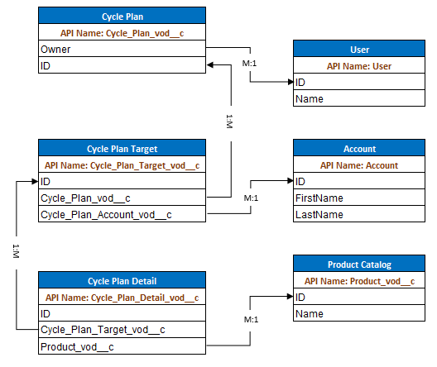
Cycle Plan Data Model

Slide 14
VEEVA Cycle Plan
Configuration Of Cycle Plan layouts
20-07-2023

Slide 15
Configuring Cycle Plan Page Layout
Configuring Cycle Plan detail page:
  Navigate to Setup → Create → Objects → Cycle Plan → Page Layouts
  Click on the edit link for a Page Layout which needs to be configured
  Add relevant fields to the Cycle Plan detail section such as
    Start Date
    End Date
    Territory
    Remaining
    Active – Only active cycle plan will be displayed on offline device

Slide 16
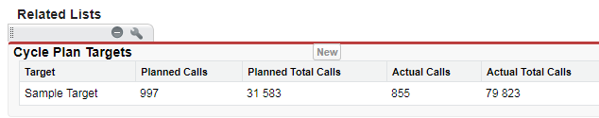
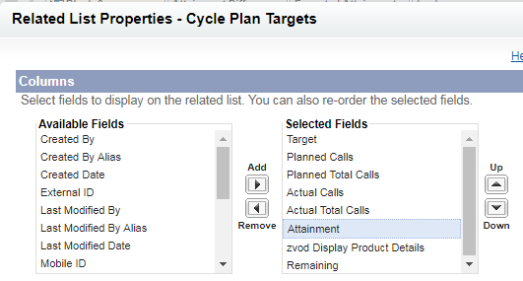
Configuring Cycle Plan Targets Section…1
Configuring Cycle Plan Targets related section on Cycle Plan detail page layout:
  Navigate to Setup → Create → Objects → Cycle Plan → Page Layouts
  Click on the edit link for a Page Layout which needs to be configured
  Scroll down to the Cycle Plan Targets related section
  Open the related list properties window
  Add/remove fields as required

Slide 17


Configuring Cycle Plan Targets Section…2
To display Product level call activity, select the zvod_Display_Product_Details field as a column of Cycle Plan Targets related list
For product level call activity, 3 columns appear for each product selected on a user’s My Setup tab:
  Actual
  Planned
  Attainment %

Slide 18
Configuring Cycle Plan Targets Section…3
In order to display the number of Planned and Actual calls for the logged in user, please select Actual Calls field as a column of Cycle Plan Targets related list
  This will add the Planned Calls and Attainment fields to related list
In order to display the number of Planned and Actual calls for the team, please select Actual Total Calls field as a column of Cycle Plan Targets related list
  This will add Total Planned Calls and Total Attainment fields on the related list

Slide 19
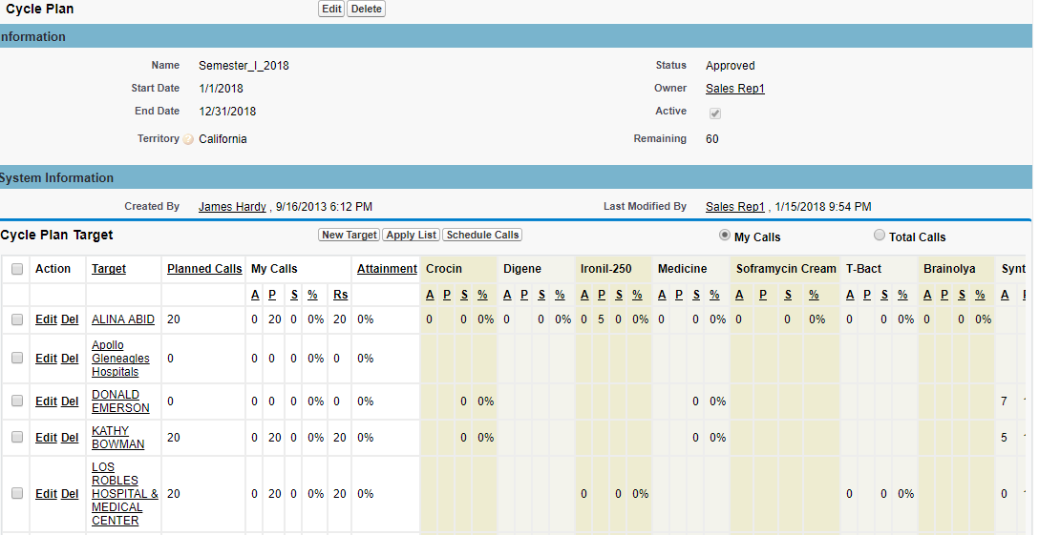
Configuring Cycle Plan Page Layout
Cycle Plan Page Layout from online application

Slide 20
Configuring Cycle Plan Page Layout...1
Custom buttons on Cycle Plan Target
  New Target button can be placed on Cycle Plan Target detail layout. This button is used to add new Account to Cycle Plan Targets
  Apply List button can be used on layout to add Accounts from an Account List
  Schedule Calls button on Cycle Plan Target layout helps in scheduling calls for selected accounts
Lock_vod field in the Cycle Plan object controls whether a Submitted Cycle Plan can be updated.
FLS can be provided to specific group of users who can be allowed to edit a Submitted Cycle plan

Slide 21
Configuring Cycle Plan Page Layout...2
Custom Marker fields can be created in Cycle Plan Target object in order to display Account, Address and TSF information on Cycle Plan layout
  The naming convention of the custom marker fields need to be zvod_ObjectReference_FieldName
    The Object Reference can be either ACCOUNT, ADDRESS or TSF
    The Field Name is the name of the field (Not API Name) for which the value needs to be populated
    For example, zvod_ADDRESS_State_vod will display state information from address
  Data type must match the data type of the corresponding field
  The new custom marker field should be added to the Cycle Plan Targets related list in the Cycle Plans Layout

Slide 22
Configuring Cycle Plan Page Layout...3
If a field of ADDRESS is referred to in the marker field, the information of the Preferred Address only will be displayed
In case Preferred address is not present then information from Primary Address will be displayed
TSF information will be displayed based on the TSF having the Cycle Plan Target account and Cycle Plan territory combination

Slide 23
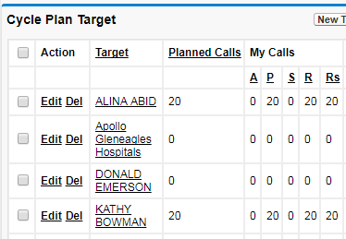
Remaining Call Count
The Cycle Plan Target List can be configured to display the number of remaining calls for a particular Cycle Plan Target
In order to enable this functionality, set the ENABLE_CYCLE_PLANS_REMAINING VEEVA Setting to True. Once enabled, the Attainment % column will be replaced by the Remaining (R) column
Remaining (R) = Planned - Actual
Note:
This feature is available on the Online and iPad platforms

Slide 24
Product Metrics in Cycle Plan…1
The Product Metrics fields can be configured to be displayed in Cycle Plan in the Product level of a Cycle Plan Target Detail
In order to configure this functionality, follow the below steps:
  Create a custom field in Product Metrics object (existing custom field can also be used)
  Create an associated custom field in Cycle_Plan_Detail_vod object. The API name of this field should follow the naming convention zvod_PM_ProductMetricsFieldName
  Here the ProductMetricsFieldName is not the Field API Name, but the field name
Note:
This feature is available on the Online and iPad platforms

Slide 25
Product Metrics in Cycle Plan…2
Apart from Inherited Product Metrics fields, Editable fields can also be configured in the Product level of a Cycle Plan Target Detail
These fields can be loaded or editable by the user. They can be read-only or editable based on page layout and Field Level Security
In order to configure page layout of inherited fields and editable fields create two different sections on Cycle_Plan_Detail page layout – Cycle_Plan_Detail_vod and the other Total_Cycle_Plan_Detail_vod – and drag desired fields into the layout of each section

Slide 26
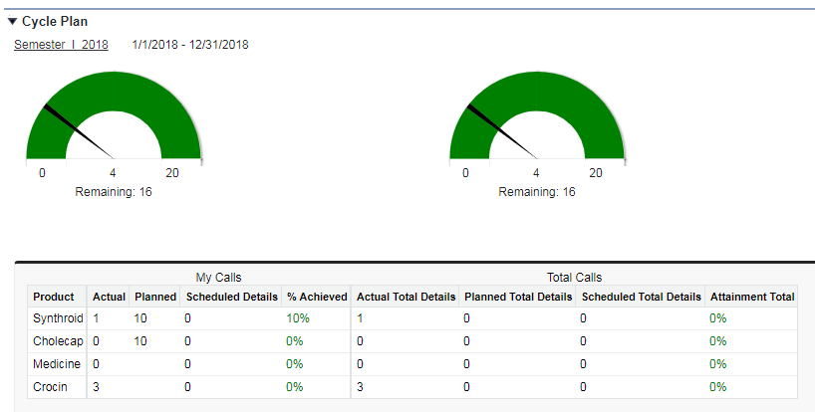
Cycle Plan on Account Page
The Cycle Plan information can be made available on Account Detail page. This enables users to have a view of Cycle Plan Goals and Targets against a particular Account along with the account profile in Account page.
In order to expose the Cycle Plan information on Account Detail Page please follow the below steps:
Add the Account_Cycle_Plan_vod S-Control to the Account page layout
Provide users with access to the Account_Cycle_Plan_vod Visualforce page
Provide relevant values in Cycle Plan Target related list in the Cycle_Plan_vod object
Note:
This feature is available on the Online and iPad platforms

Slide 27
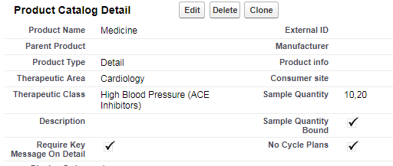
Exclude Products from Cycle Plan
Products can be configured such that they are not displayed in Cycle Plan
This functionality is available for products of Product Type ‘Detail’ only
The No Cycle Plans field in Product Catalog page is used to drive this functionality
Marking this field as TRUE for any Detail product will exclude the product from Cycle Plan

Slide 28
VEEVA Cycle Plan
Configuration of user profiles for Cycle Plans
20-07-2023

Slide 29
Configuring User Profiles
Apart from the above, provide permissions to following visualforce pages in user profiles/permission sets:
View_Cycle_Plan_vod
Edit_Cycle_Plan_vod
Desired Action | Configuration Required
Create Cycle Plans | Provide Read, Create, Update and Delete (optional) permissions to users on Cycle_Plan_vod object
Add new Targets to existing Cycle Plan | Provide Read, Create, Update and Delete(optional) permissions to users on Cycle_Plan_Target_vod object
Relate Call product Details to Cycle Plan Targets | Provide Read, and Update permissions to users on Cycle_Plan_Detail_vod object

Slide 30
VEEVA Cycle Plan
Configuration of Cycle Plan For Batch calculation process
20-07-2023

Slide 31
Cycle Plan Batch Process…1
There are two Apex classes which update Cycle Plans with calls and details that were performed by users
These classes can be scheduled to run on specified intervals. In order to do so please follow the below steps:
  Provide System Administrator user with access to the Apex classes VEEVA_BATCH_CYCLE_PLAN_CALC and VEEVA_BATCH_CYCLE_PLAN_CALC_CALLS
  Create a new Apex Class that implements Schedulable. Inside this class instantiate the Apex classes mentioned above
  On the Apex Classes page, click the Schedule Apex button
  Provide a Job name, select the class created in step 2 and mention the frequency at which the job needs to run

Slide 32
Cycle Plan Batch Process…2
If the Apex classes VEEVA_BATCH_CYCLE_PLAN_CALC and VEEVA_BATCH_CYCLE_PLAN_CALC_CALLS need to be modified to meet certain business requirements then,
  Clone and rename the classes
  Modify the code inside the cloned classes
  Create an Apex class that implements Schedulable and instantiate the cloned classes
  Schedule the Apex class created in Step 3

Slide 33
VEEVA Cycle Plan
Configuration of Cycle Plan For Real-time calculation process
20-07-2023

Slide 34
Real Time Calculations…1
Call activities can be updated more frequently on Cycle Plans using Real Time calculations
This helps user in tracking their goals and achievements (My Calls) immediately and hence enable them to take more immediate action on calls
For this functionality to work, the Cycle Plan must be unlocked
In order to configure this functionality, the below VEEVA Settings and VEEVA Messages need to be used as follows:
  VEEVA Settings
    CALC_CYCLE_PLANS_REALTIME: Mark this as TRUE in order to enable real time Cycle Plan calculation
    CALC_CYCLE_PLANS_ACTUAL: Refers the VEEVA Message to define the query of what calls should be used for real time calculation of Actual counts.
      Default value: CALC_CYCLE_PLANS_ACTUAL;;CyclePlan
    CALC_CYCLE_PLANS_SCHEDULED: Points to the VEEVA Message to define the query of what calls should be used for calculation of Scheduled counts.
      Default value: CALC_CYCLE_PLANS_SCHEDULED;;CyclePlan

Slide 35
Real Time Calculation…2
VEEVA Message
  CALC_CYCLE_PLANS_ACTUAL: The where clause SOQL definition of the query for which calls are used for real time cycle plans calculation of Actual counts
  CALC_CYCLE_PLANS_SCHEDULED: The where clause SOQL definition of the query for which calls are used for real time cycle plans calculation of Scheduled counts
A batch job is still required to run in order to calculate team calls

Slide 36
Cycle Plan in iRep
iRep Home Page
  On iRep Home Page the Cycle Plan is displayed as a graphical summarization of the current cycle plan of a user
  It illustrates the user's progress to goal for the entire plan
My Schedule
  Cycle Plans can be accessed by user from My Schedule in iRep application
  Cycle Plan information is available as Read Only in the Weekly scheduler in iRep
  Users can tap on an account to view Cycle Plan details for that account
  Users can apply a pre-determined list of Accounts in weekly scheduler to access the Cycle Plan information faster
  Additionally, users can also filter by Cycle Plan
  Cycle Plan information is also available in the Scheduler tab of My Schedule
  User can apply a Cycle Plan filter here too

Slide 37
Cycle Plan Info – Week View..1
Cycle Plans can be accessed from the My Schedule on iRep
  Users must have an active Cycle Plan for it to display
  Filter by Cycle Plan

Slide 38
Cycle Plan Info – Week View..2
  Tap an Account to view additional Cycle Plan information

Slide 39
Cycle Plan Info – One Touch Scheduler
Tap the Scheduler tab and filter by Cycle Plan

Slide 40
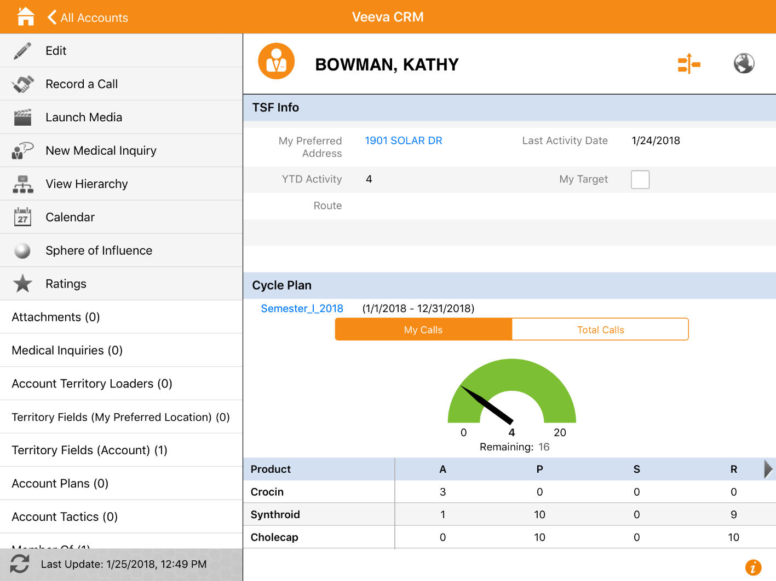
Cycle Plan Info – Account Detail Page
User can view the cycle plan related detailed information from the account detail page

Slide 41
Check Your Understanding ... 1
1. Cycle Plan cannot be displayed on Account detail page.
State True or False
True
False
Answer: False

Slide 42
Check Your Understanding ... 2
2. Which of the below is not a VEEVA Cycle Plan data model object?
Cycle_Plan_vod__c
Cycle_Plan_Target_vod__c
Cycle_Plan_Product_vod__c
Cycle_Plan_Detail_vod__c
Answer: Cycle_Plan_Product_vod__c

Slide 43
Check Your Understanding ... 3
3. Which of the below is not a VEEVA provided Custom Button in Cycle_Plan_Target_vod object?
New Target
Schedule Calls
Apply List
Create Bookmark
Answer: Create Bookmark

Slide 44
Check Your Understanding ... 4
4. Which field in Product Catalog is used to exclude a Product from Cycle
Plans?
No_Cycle_Plans_vod
No_Metrics_vod_c
No_Promo_Items_vod_c
No_Details_vod_c
Answer: No_Cycle_Plans_vod

Slide 45
Check Your Understanding ... 5
5. Which two Apex classes are used to update Cycle Plans with calls and details that were performed by users?
Choose 2 answers
VEEVA_BATCH_CYCLE_PLAN_CALC
VEEVA_CYCLE_PLAN_CALC_CALLS
VEEVA_CYCLE_PLAN_CALC
VEEVA_BATCH_CYCLE_PLAN_CALC_CALLS
Answer: VEEVA_BATCH_CYCLE_PLAN_CALC and VEEVA_BATCH_CYCLE_PLAN_CALC_CALLS

Slide 46

Summary
  In this module, you have learnt to:
    Define VEEVA Cycle Plan
    Explain where Cycle Plan is visible in application
    Define various Cycle Plan Target Statistics Columns
    Describe Cycle Plan data model
    Configure Cycle Plan layouts
    Configure user profiles for Cycle Plans
    Configure Cycle Plans batch and real-time calculation processes

Slide 47
Coming Next ...
In the upcoming module - Sample Management, you will learn about:
  VEEVA Sample Management Data Model
  Sample Lot and Lot Catalog
  Sample Transactions
  My Samples Tab
  Sample Limit

Slide 48
Source
https://crmhelp.VEEVA.com/doc
Disclaimer: Parts of the content of this course is based on the materials available from the Web sites and books listed above. The materials that can be accessed from linked sites are not maintained by Cognizant Academy and we are not responsible for the contents thereof. All trademarks, service marks, and trade names in this course are the marks of the respective owner(s).

Slide 49
Thank you
  You have successfully completed
  VEEVA Cycle Plan

